Slide 1
Flow Cytometry
Next Generation Pathology Lectures
Paul D. Simonson, M.D., Ph.D.
Weill Cornell Medicine
September 23, 2021, Room C405, 5 p.m. to 6:30 p.m.

Slide 2
Pre-requisites for following the exercises
Install FlowJo (available for Mac and Windows)
Download and install FlowJo from https://www.flowjo.com/solutions/flowjo/downloads
Activate 30-day free trial at https://www.flowjo.com/solutions/flowjo/free-trial (it may take up to one day for the trial serial number to be activated!)
OR choose student license (free)
OR paid licenses are also available through WCM ($250 per year)
Install R, Rstudio, and R packages (available for Mac, Windows, and Linux)
Install R if it is not installed already. One option is to follow the instructions found here: http://lib.stat.cmu.edu/R/CRAN/
Download and install RStudio Desktop (open source license, free) from https://www.rstudio.com/products/rstudio/download/.
Install the packages necessary to make an R Notebook.
Within Rstudio, choose File > New File > R Notebook
If the necessary packages are not installed, Rstudio will ask for permission to install them. Allow them to be installed.
Within Rstudio, install the “flowCore” package. Follow the installation instructions found here (enter commands in the “Console” tab): https://www.bioconductor.org/packages/release/bioc/html/flowCore.html.
Install the “umap” package by entering the following in the “Console” tab: install.packages(“umap”)

Slide 3
Objectives
Basic introduction to flow cytometry (technique, applications, etc.)
Discuss and apply basic gating to flow cytometry data
Discuss and apply the UMAP algorithm to flow cytometry data
Discuss supervised machine learning for flow cytometry

Slide 4
Clinical Flow Cytometry
Commonly performed flow cytometry tests:
Lymphocyte subset enumeration
CD4 subsets (HIV), immunodeficiency
CD3 expression (solid organ transplant)
CD34 stem cell (blast) enumeration
Reticulocyte enumeration
Paroxysmal nocturnal hemoglobinuria (PNH) testing
DNA cell cycle / ploidy analysis
Leukemia/lymphoma immunophenotyping
Notes:
Rapid robust multiparameter analysis of single cells
By measure fluoresence intensity produced by fluorochrome labeled antibodies binding to targeted cell specific proteins
On this platform numerous assays can be performed allowing for such clinical uses as

Slide 5
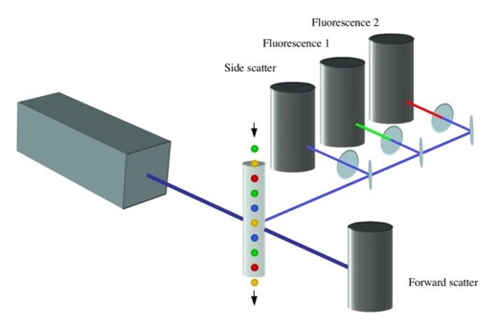
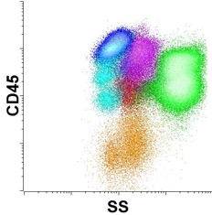
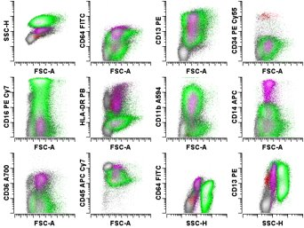
A quick introduction to flow cytometry
Uses panels of fluorescent antibodies and light scattering to characterize single cells as they pass through a capillary tube
Helpful in diagnosing leukemia, lymphoma, etc.
Interpretation of data is performed by hematopathologists by “gating” and visual interpretation of data

Slide 6
Advantages of flow cytometry
Can analyze millions of cells from a single sample
Good for finding rare cell types
Makes good use of small biopsy specimens
Rapid
Quantitative
Flexible
Notes:
The power of single cell analysis is compounded by the
ability to measure multiple parameters simultaneously on each individual cell, to do this very fast (in excess
of 20,000 cells/second), and to isolate/purify/sort desired subpopulations

Slide 7
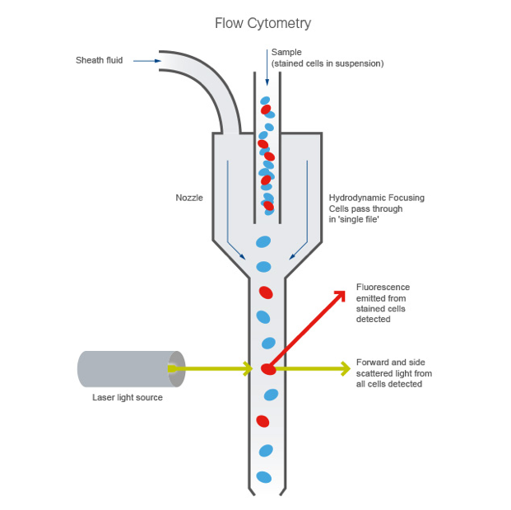
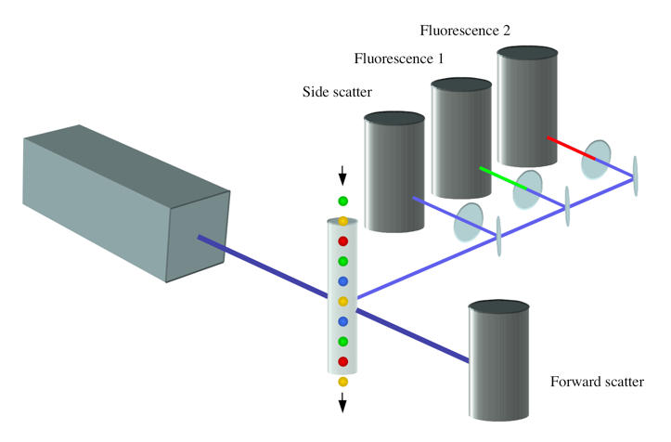

Slide 8
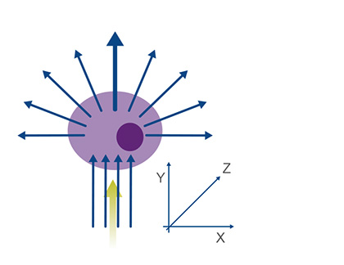
What is light scatter?
Photons pass through a cell and get “scattered” in different directions.
What we measure in flow cytometry:
0º light scatter (forward scatter)
Related to cell size (higher forward scatter = larger cells)
Decreases as cells degenerate
90º light scatter (side scatter)
Related to cell cytoplasmic granularity/complexity
Decreases as cells degenerate

Slide 9
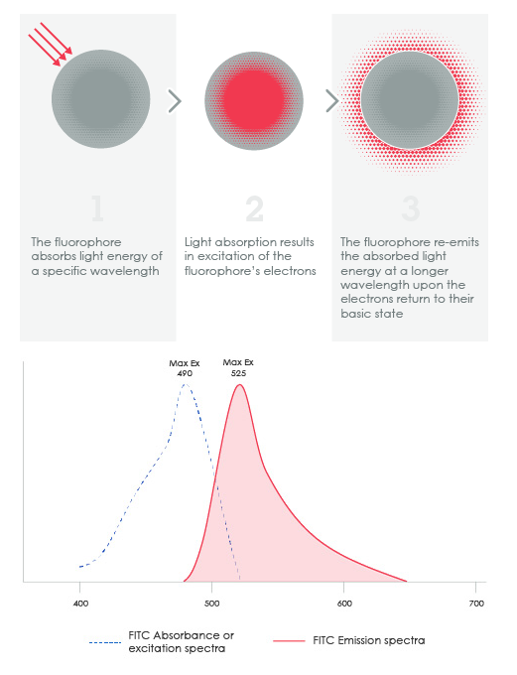
What is fluorescence?
Light of a short wavelength is absorbed by a molecule and re-emitted at a longer wavelength.
The fluorescent molecules used in laboratory work are often referred to as “fluorophores” or “fluorochromes.”
Fluorophores can be attached to antibodies, which are used to detect antigens in cells.

Slide 10
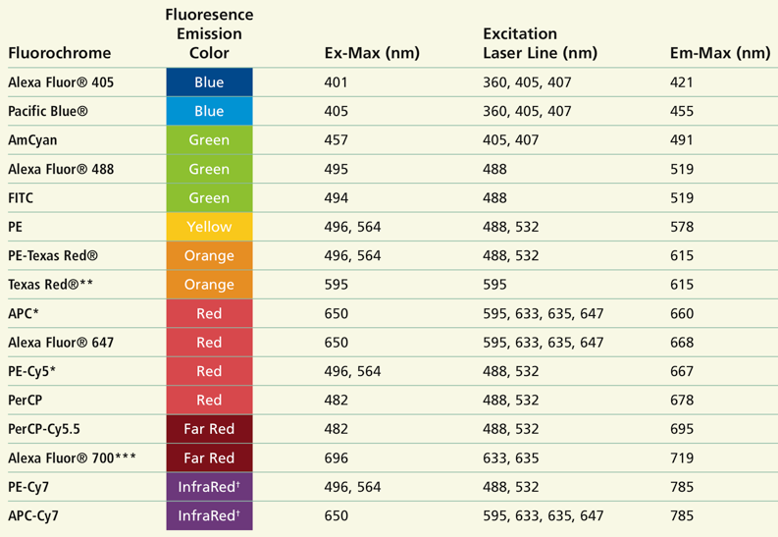
Common fluorochromes
From Becton-Dickinson Web Site
Notes:
A general guideline for the relative intensities of the various fluorochromes is, from brightest to dimmest, PE, PE-Cy 7, PE-Cy5, APC, APC-Cy7, Alexa Fluor 647®, Alexa Fluor 700®, FITC, Pacific Blue, Alexa Fluor 488®. This is a general pattern; some differences in the relative intensities are seen for individual antibodies.

Slide 11
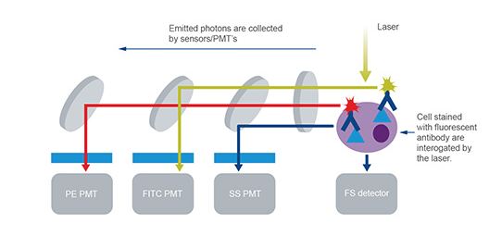
How to detect fluorescence from multiple fluorophores: series of selectively reflective mirrors and light filters
Notes:
Forward and side scattered light and fluorescence from stained cells are split into defined wavelengths and channeled by a set of filters and mirrors within the flow cytometer. The fluorescent light is filtered so that each sensor will detect fluorescence only at a specified wavelength. These sensors are called photomultiplying tubes (PMTs).

Slide 12
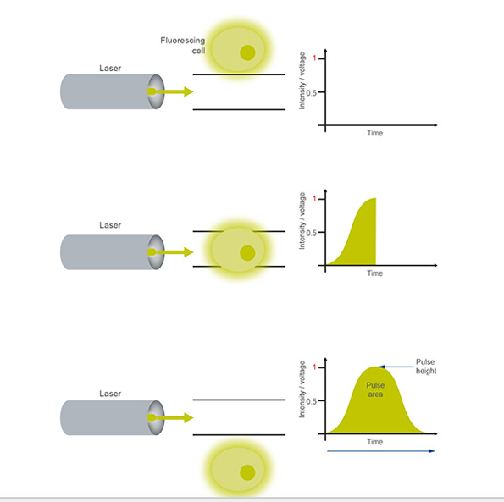
Acquired signals
As cell passes through the detector, the signal intensity gradually increases, then decreases
Values stored by the computer:
Signal height: maximum signal intensity (i.e., the “peak” value)
Signal area: total “area under the curve”
Useful for detecting two cells that are passing through at nearly the same time
Notes:
AAs the fluorescent labeled cell passes through the optics and is interrogated by the laser, photons are emitted and so the intensity of the voltage measured increases. As each fluorescing cell completes its path through the laser beam, this leaves a pulse of voltage over time based on number of photons emitted over time. These are detected by the PMT and converted to a voltage pulse, known as an event. The total pulse height and area is measured by the flow cytometer. The measured voltage pulse area will correlate directly to the intensity of fluorescence for that event.

Slide 13
The summarized output: “dot plots”/histograms
Each point corresponds to a single cell or cluster of similar cells
2-dimensional scatter plots are made for different pairs of antigens

Slide 14
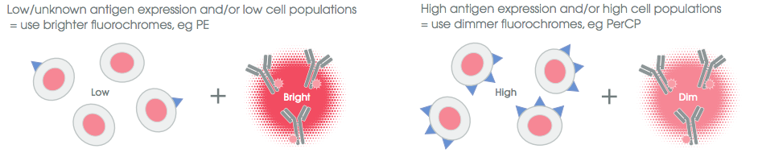
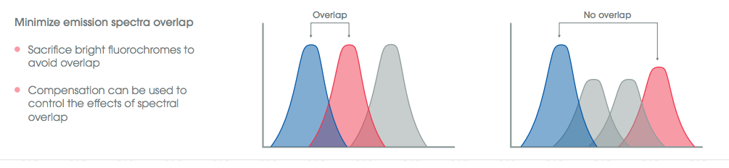
Considerations for designing flow cytometry antibody panels

Slide 15
CD (Cluster Designation) antigens correspond to antigens on cell surfaces
Examples: CD3, CD20, CD45, etc.
Cell surface antigens are used because they are easy to detect (no permeabilization of cell membrane required)
Biooncology.com

Slide 16
Commonly Used CD Antigens
CD Antigen | Cell type
CD3 | T cells
CD4 | Helper T cells, monocytes
CD8 | Cytotoxic T cells
CD16, CD56 | NK cells
CD19, CD20 | B cells
CD13, CD33 | Myelomonocytic cells
CD34 | Stem cells
CD64 | Monocytes
CD14 | Mature mononocytes

Slide 17
Example Panels of Antibodies
Fluorochromes and antibodies
 | PB | FITC | PE | PE-TR | PE55 | PE7 | A594 | APC | A700 | APC7
B cells | CD45 | κ | λ | CD19 | CD34 | CD20 | CD38 | CD10 | - | CD5
T cells | CD45 | CD2 | CD7 | CD34 | CD8 | CD3 | CD4 | CD56 | - | CD5
Blasts | HLA-DR | CD15 | CD33 | CD19 | CD117 | CD13 | CD38 | CD34 | CD71 | CD45
Myeloid | HLA-DR | CD64 | CD123 | CD4 | CD14 | CD13 | CD38 | CD34 | CD16 | CD45
Panel names

Slide 18
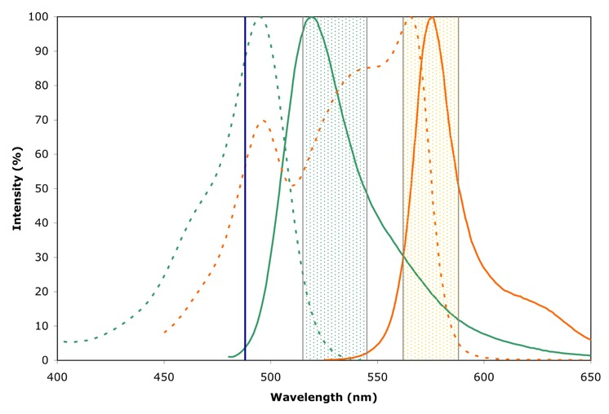
The need for fluorophore compensation
Fluorochromes do not emit light at just one wavelength. They have emission spectra.
Emission spectra for similar fluorophores can overlap.
The overlap will result in light being detected in more than one channel, even though only one fluorochrome is present.
Mathematical “compensation” is applied to correct for the overlap detected in multiple detector channels.
FITC = Green
PE = Orange
Excitation = Dotted
Emission = Solid

Slide 19
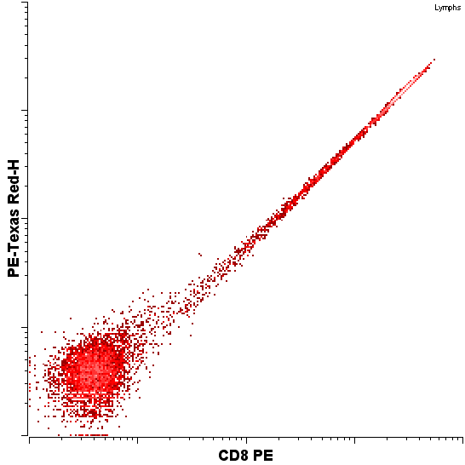
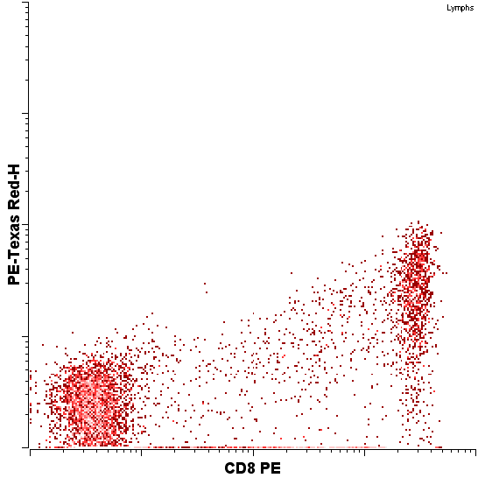
Lack of Compensation
After compensation

Slide 20
Collection/storage of cells
Of anticoagulants, cells are best stored in heparin
RPMI is a cell nutrient solution that helps maintain cell viability
Refrigeration slows degradation
Some cells degrade faster than other cells
Commons.Wikimedia.org

Slide 21
Sample processing
100 μl whole blood
Add antibodies
Incubate
Add red blood cell lysing reagent and incubate
Wash to remove debris and lysing reagent
Fix in paraformaldehyde (optional)
Send it through the flow cytometer!
Commons.Wikimedia.org
Notes:
n direct immunofluorescence staining, cells are incubated with an antibody directly conjugated to a fluorochrome (e.g. FITC). This has the advantage of requiring only one antibody incubation step and eliminates the possibility of non-specific binding from a secondary antibody.

Slide 22

Quiz
In flow cytometry, increased forward scatter usually indicates:
a. Increased cell size
b. Decreased cell maturity
c. Increased cell complexity
d. Decreased cytoplasmic granularity

Slide 23
Variants of flow cytometry
Hematology analyzers (for measuring CBC): No fluorescence, but measures scattering and electrical impedance
CyTOF: Flow cytometry combined with mass spectrometry for detection (instead of fluorescence). Subject of a later lecture…
Bead assays: Fluorescent beads with antibodies attached are measured, not cells.

Slide 24
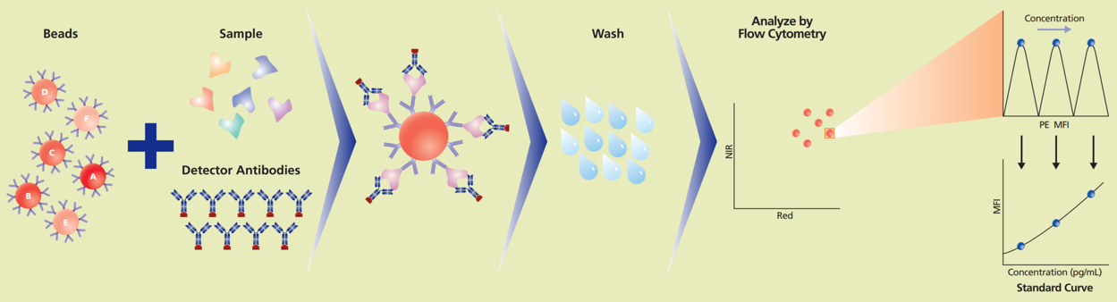
Bead assays
Beads are designed to have unique combination of fluorophores and intensities
Using a sandwich approach, analytes can be detected (cytokines, etc.)
https://www.bdbiosciences.com/content/dam/bdb/marketing-documents/CBA_Brochure_Intl.pdf

Slide 25
Analyzing the Data

Slide 26

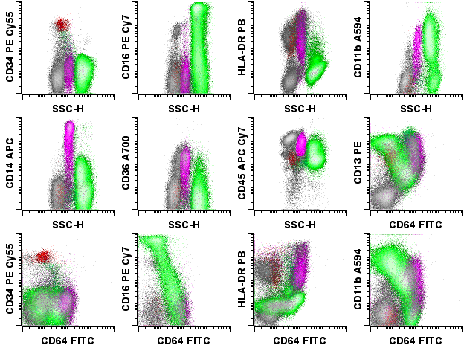
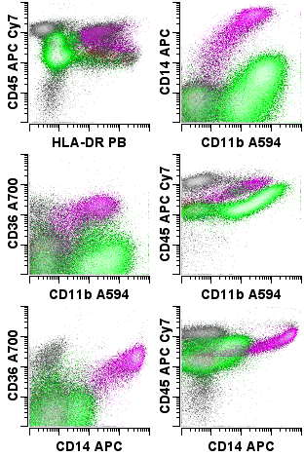
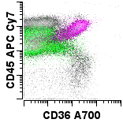
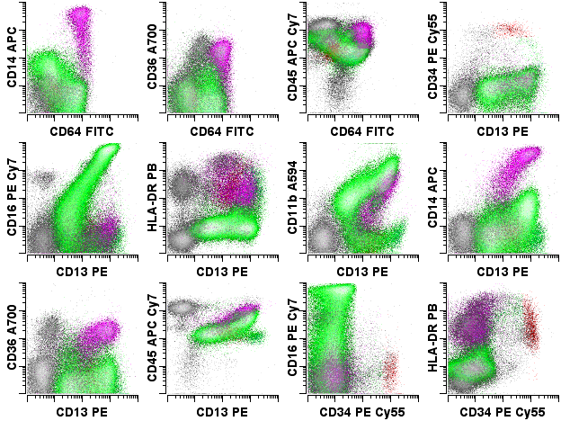
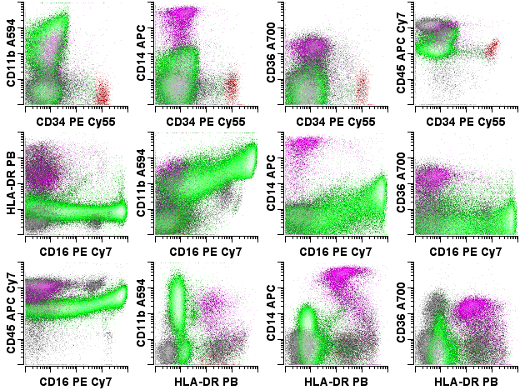
Pattern recognition
55 unique combinations

Slide 27
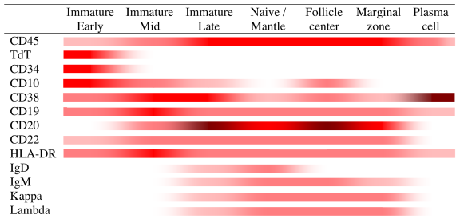
Normal B cell Maturation
Wood and Borowitz (2006) Henry’s Laboratory Medicine

Slide 28
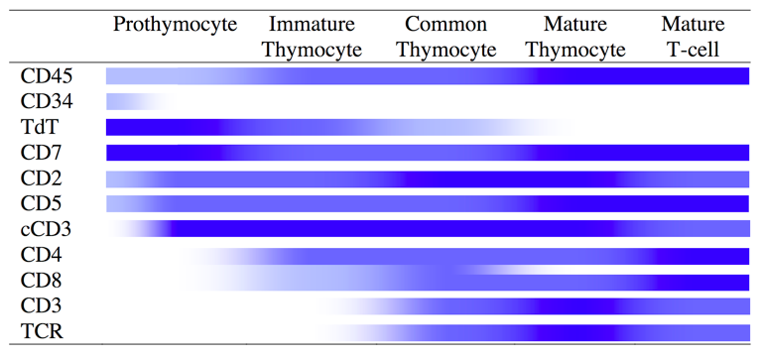
Normal T cell Maturation
Wood and Borowitz (2006) Henry’s Laboratory Medicine

Slide 29
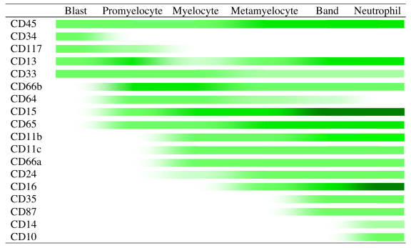
Normal Myeloid Cell Maturation
Wood and Borowitz (2006) Henry’s Laboratory Medicine

Slide 30
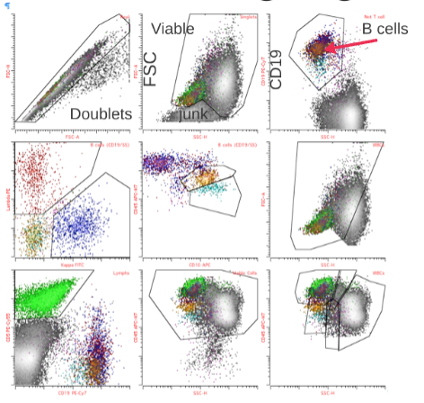
Gating
Identifies a subgroups of data points within the dataset
Usually performed graphically on histograms
Boolean logic used to combine gates
And, Or, Not, etc.

Slide 31
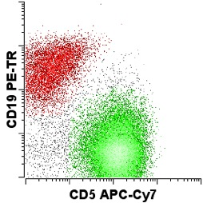
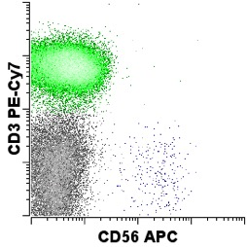
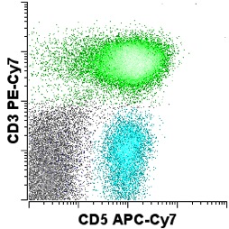
Inferential reasoning
Sometimes we want to run more antibodies than the machine can handle. We then have to run two tubes of antibodies with cells and infer whether one cell population in one tube is the same as that in another tube for the two antibody panel tests.
18%
66%
80%
0.4%
Inference is less preferred since sometimes our assumptions are incorrect, and we cannot apply it to individual cells.
Solution: Build flow cytometers with more detector channels

Slide 32
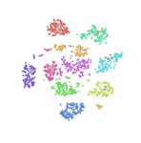
Letting a computer identify the cell populations for us
Unsupervised machine learning (no data annotation): finds patterns, associations, clusters, etc.
GMM, FlowSOM, SPADE, etc.
t-SNE
UMAP

Slide 33
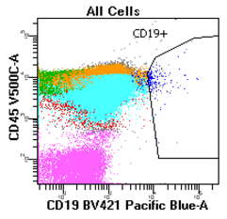
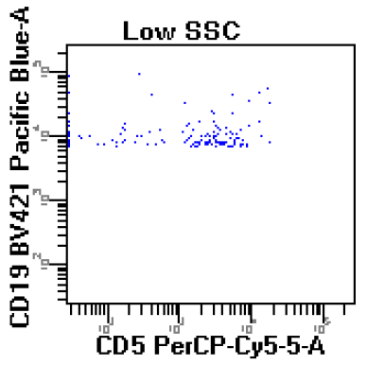

The increasing need for clustering algorithms
More colors --> more scatter plots --> more complex analysis for humans
"Contamination" of gates
Unsupervised clustering:
Considers all parameters at once to find cells that are similar to each other
Creates low-dimensional representations that are easier to interpret by humans
Makes it easier to cleanly parse populations
Notes:
Flow case: patient with a history of lambda+ mantle cell lymphoma who has undergone treatment that includes rituximab.

Slide 34

What is t-SNE?
Converts high-dimensional data to clusters in two-dimensions
Dissimilar clusters are (generally) farther apart
Already available in some commercial flow cytometry software
Drawback: For each data set, the clusters end up in different locations
https://www.oreilly.com/content/an-illustrated-introduction-to-the-t-sne-algorithm/
Notes:
When we consider that the number of 2D scatter plots increases exponentially with the number of parameters, which are increasing as new 20-color flow instruments are becoming more common, the utility of finding new ways to represent this higher dimensional data in two-dimensional plots becomes clear.

Slide 35
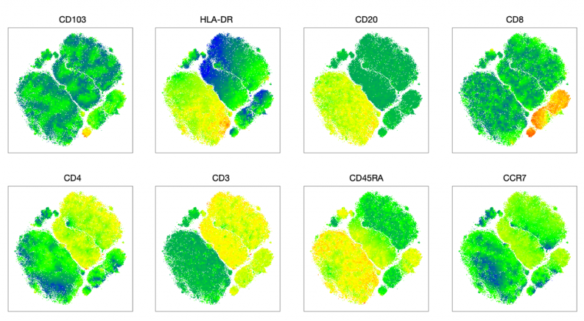
Interpreting t-SNE clusters by marker intensity
https://marissafahlberg.com/a-basic-overview-of-using-t-sne-to-analyze-flow-cytometry-data/​

Slide 36
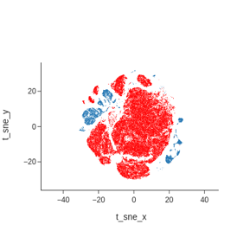
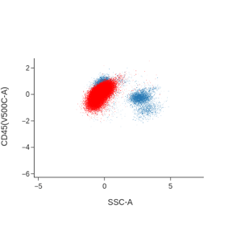
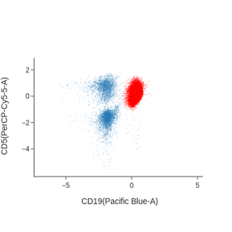
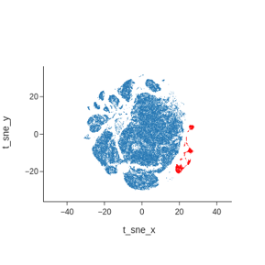
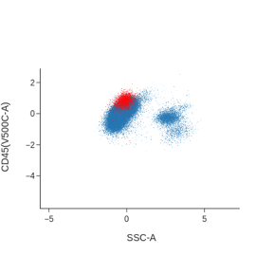
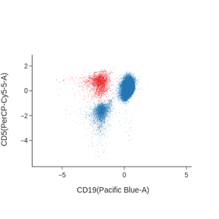
Interpreting t-SNE clusters by gating
Example: Bone marrow involved by CLL (86% of cellularity)
T-SNE calculated using:
FSC-H,
SSC-H
sKappa
SLambda
CD5
CD23
CD10
CD20
CD19
CD45
Notes:
5 min 12 s

Slide 37
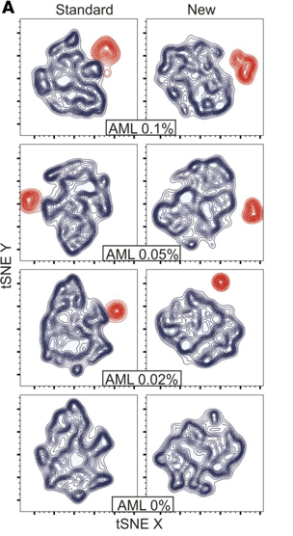
Using t-SNE to optimize an AML MRD panel
Dissimilar cell populations are farther apart
Better choices of antibodies can make the separations cleaner
Changing antibody panels and looking at MRD population separation by t-SNE made a better panel
Coustan-Smith E et al. Universal monitoring of minimal residual disease in acute myeloid leukemia. JCI Insight. 2018;3(9):e98561.
Notes:
https://insight.jci.org/articles/view/98561/figure/7

Slide 38
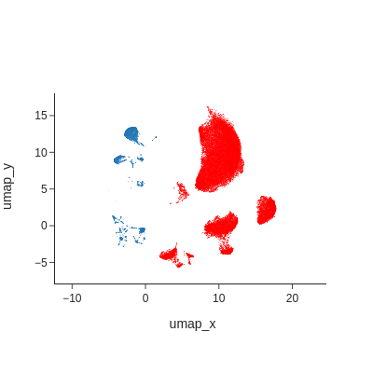
UMAP
Reduces high-dimensional data to two-dimensional representations
Better preserves relationships between cells and clusters
"Embeddings" can be saved and used again with data from new samples --> cell populations will show up in the expected locations
Bone marrow involved by CLL (86% of cellularity)
Notes:
52.7 s to compute, 100,000 cells

Slide 39

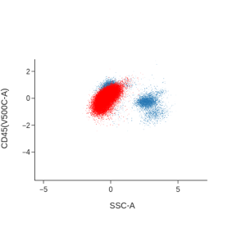
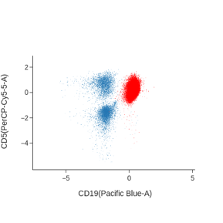
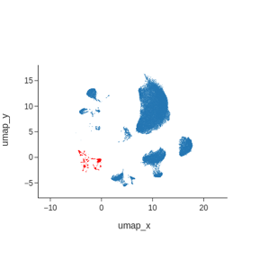

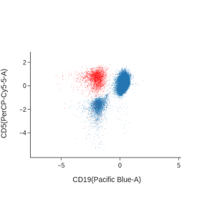
Example gating using UMAP
UMAP calculated using*:
FSC-H
SSC-H
sKappa
sLambda
CD5
CD23
CD10
CD20
CD19
CD45
*Same as for prior t-SNE.

Slide 40
Comparing t-SNE and UMAP...

Slide 41
Exercises

Slide 42
FlowJo Exercise: Basic Gating
Open FlowJo.
Drag the folder “CLL” into the FlowJo window.
Go to “Preferences > Workspace > Sample Display Naming” and choose “Use Short File Name”
We will make the following gates using the “B1” antibody panel data:
White Cells
Lymphocytes
B cells
Kappa light chain expression
Lambda light chain expression
Helpful video for basic introduction to FlowJo: https://www.youtube.com/watch?v=Ux0S0g6-Fvs

Slide 43
Download and unzip the GitHub repository
https://github.com/SimonsonLab/2021_Next_Gen_Flow_Lecture

Slide 44
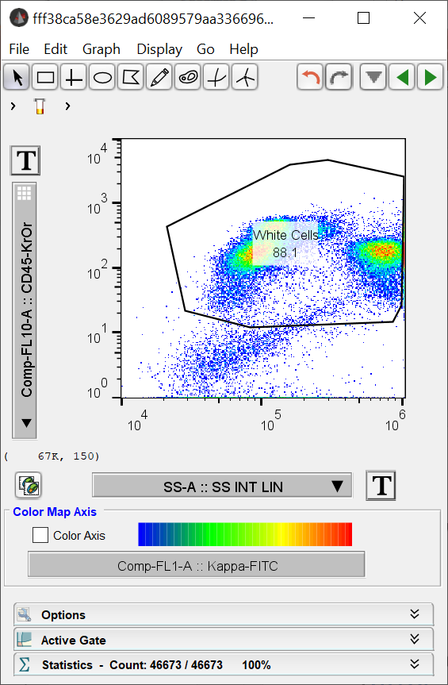
Now we try it…
We will use files from publicly available data (https://flowrepository.org/id/FR-FCM-Z2JW).
“Singlets” and compensation were already performed for these data. Viability dye was not used.
Open FlowJo and drag the “CLL” folder (from “ExampleData” folder) into the open window.
Double-click on the second file in the list.
Draw a gate around the CD45-positive cells (white cells).
Double-click inside the gate to get ready for the next step.

Slide 45
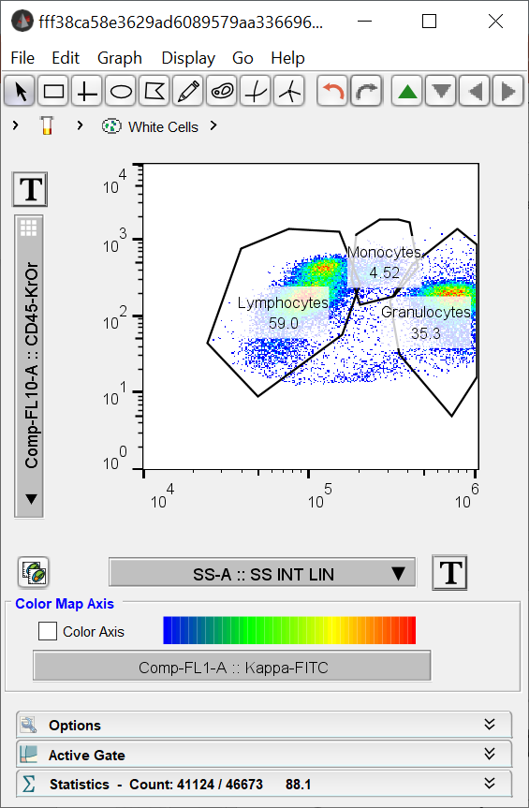
Now gate lymphocytes, monocytes, and granulocytes…
Set the x axis to side scatter (look for SS-A) and the y axis to CD45.
Lymphocytes have the least side scatter.
Try exploring the axes options by clicking on the large “T” buttons.

Slide 46
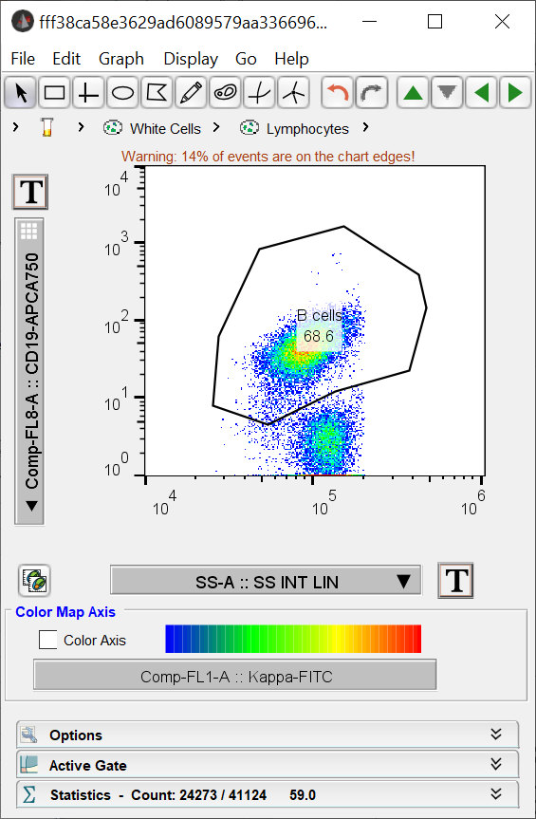
Gate B cells using CD19
Set the x axis to side scatter (look for SS-A) and the y axis to CD19.
B cells have high CD19 expression.

Slide 47
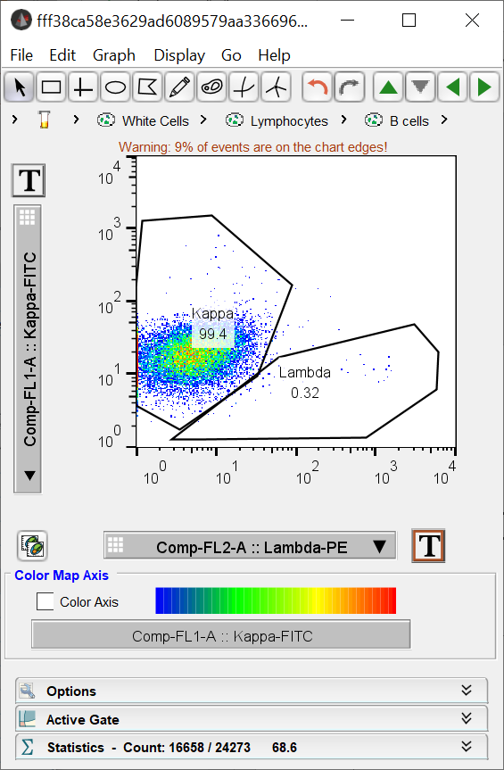
Find the kappa and lambda restricted B cell distributions

Slide 48
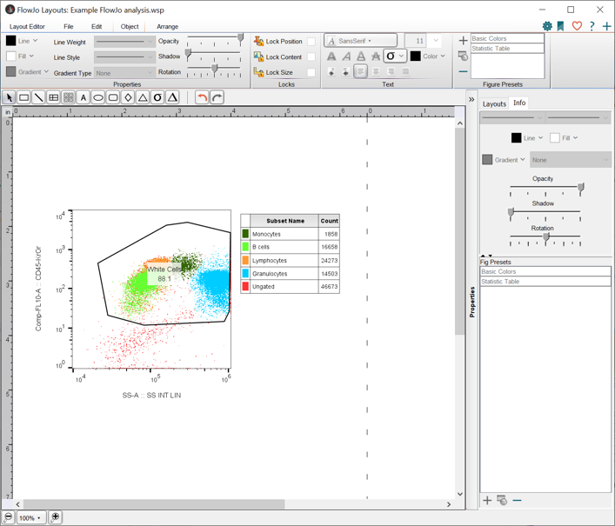
Create a report using the Layout Editor

Slide 49
Create a UMAP of flow cytometry data
Open the file “rstudio notebook.Rmd” in RStudio and run it.

Slide 50
Open the generated FCS file in FlowJo
Try drawing gates around the populations seen in the UMAP plot (set UMAP x on the x axis and UMAP y on the y axis) and see how those populations compare with the lymphocytes, monocytes, and granulocytes gated using the traditional gating approach.

